Slide 1
PYTHON PROGRAMMING
LAUNCHCODE
July 7, 2025
Asfand Khan

Slide 2
Instructor Information
Asfand Khan
Honours Bachelors of Economics from Wilfrid Laurier University
Comp. Sci courses such as Python, Excel VBA
Statistics Instructor teaching Stata, R
Worked as a Junior Researcher and Junior Policy Analyst at ESDC
Experienced SQL programmer

Slide 3
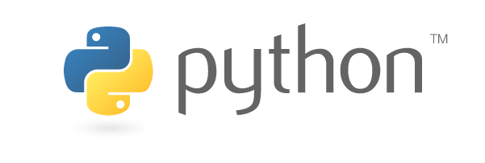
The Python Programming Language
Teaching Style
Practice over theory
Developing intuition through examples
Keeping students engaged by asking questions
Working 1-on-1 with students
Developing skills through projects

Slide 4
The Python Programming Language
How this course will progress
Review of previous week’s material
Questions to be asked at start and end of classes (+-15mins)
Instructor covers a topic
Instructor provides examples
Instructor carries out periodic knowledge checks
Class activity
Students may ask questions at any point in the class

Slide 5
Google Colab
https://colab.google/
Google Colab provides a collaborative workspace where you can:
Write and run Python code in an interactive notebook.
Access free GPU/TPU computing resources.
Import libraries like TensorFlow, NumPy, and Pandas without local installation.
Mount Google Drive to load or save files directly.
Share notebooks with others just like Google Docs.
Must need a google account (gmail)

Slide 6
The Python Programming Language
Audience
Having basic understanding of programming or worked on any High Level language like C, JAVA, or C ++, etc
At the end you will be able:
Understand the significance of Python Programming
Familiarize with the Python IDE Environment
Understand the Input and Output operations in Python
Use variables in Python language

Slide 7
What is Python Programming
Python was developed by Guido van Rossum
(a Dutch programmer) in 1991
Python is a High Level Language (whereas C and Java are not High Level Language)
Python has a design philosophy that emphasizes Code Readability
The syntax allows programmer to express concepts in fewer lines of code than might be used in languages such as C++, Java etc

Slide 8
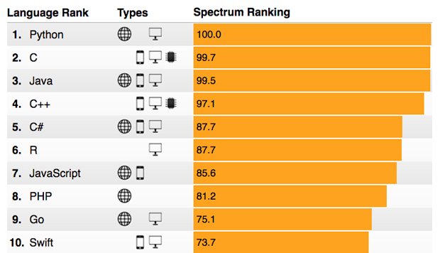
Why Python Programming
According to IEEE Spectrum the top Programming Languages in 2017 are:
http://spectrum.ieee.org/computing/software/the-2017-top-programming-languages

Slide 9
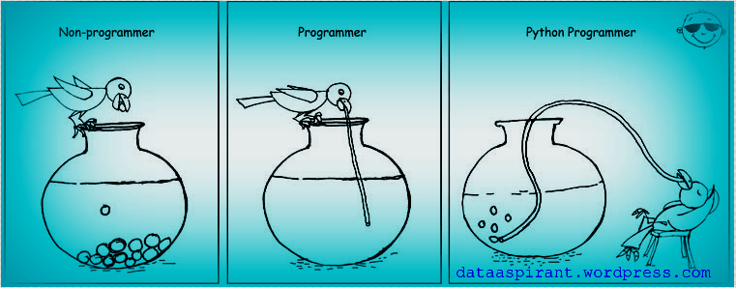
Why Python Programming
Because it Easy to learn and use: Its simple syntax is very accessible to programming novices and will look familiar to anyone with experience in Matlab, C/C++, Java. Also Python has powerful libraries

Slide 10
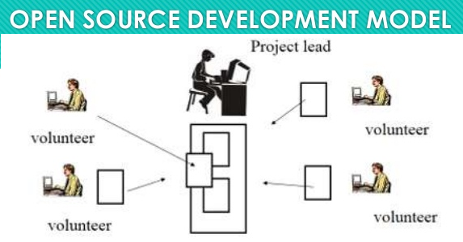
Why Python Programming
Because it is FREE
There is no worried of buying the key and or unethical use of software by cracking its key
Because it is Open Source
In the Open Source software the source code, blue print and documentation are freely available to public. The software developer voluntarily put their part to add the features in the software

Slide 11
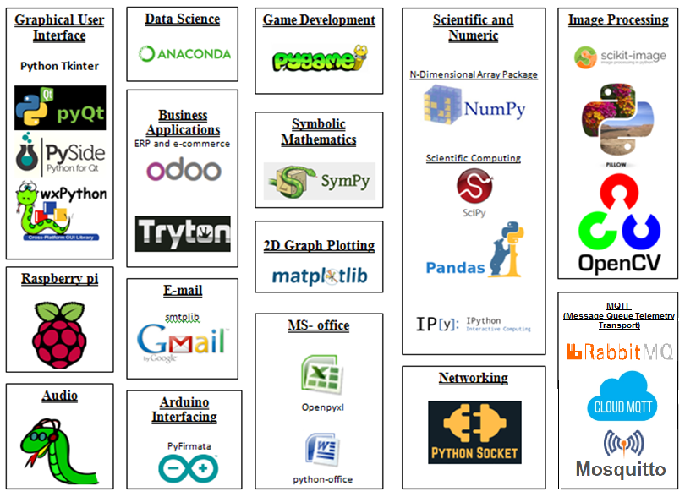
Python has vast development implementation

Slide 12
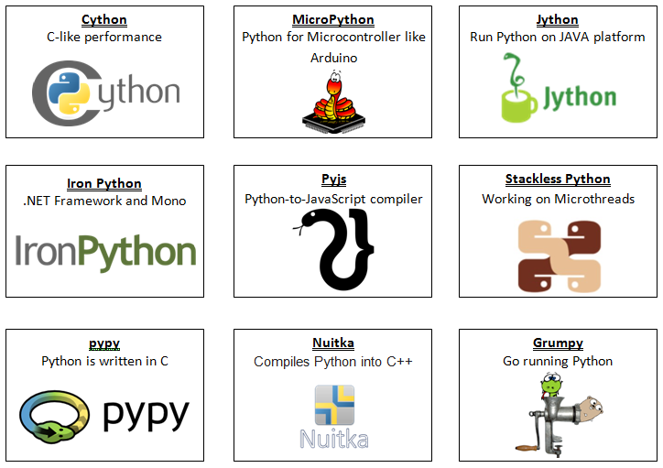
Python Cross-compilers to other languages

Slide 13
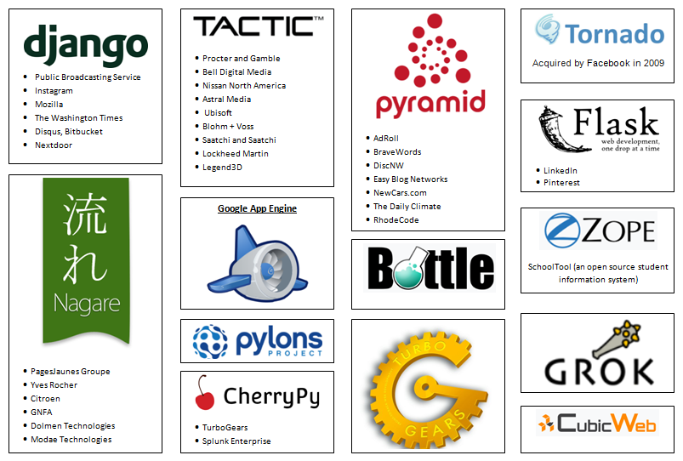
Python Web development frameworks

Slide 14
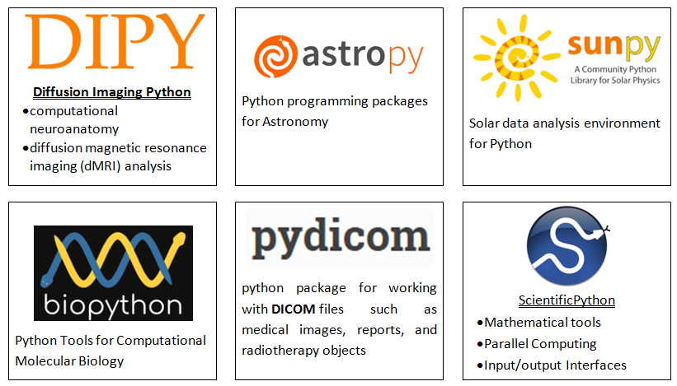
Python in other Science

Slide 15
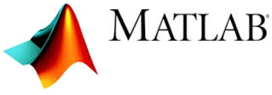

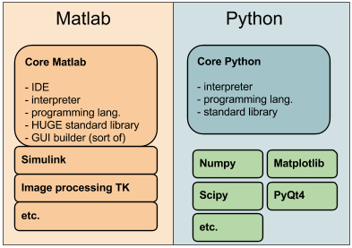

Python has Powerful Libraries

Slide 16

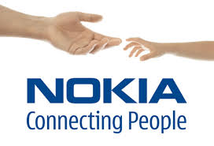







Who uses Python

Slide 17
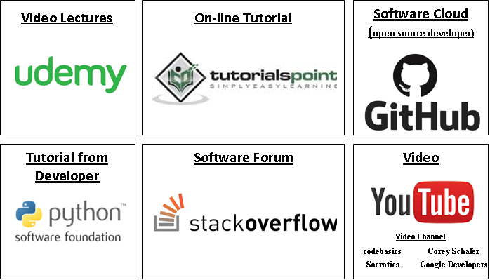
How to Learn Python

Slide 18
My First Python Program
Open Google Colab and write the following instruction
A print is an output instruction use to display string or data value on screen
print(“HELLO")
Note: Program contain no header file, no main() function, no semi column at instruction end, even you write string in single quotation mark. BUT one thing common with other programming language that is Case Sensitive
print(‘HELLO‘)

Slide 19
Output Instruction
The following are the Escape Sequence use with print instruction
Escape Sequence | Working
\\ | Backslash (\)
\' | Single quote (')
\" | Double quote (")
\n | ASCII Linefeed (LF)
\t | ASCII Horizontal Tab (TAB)
Example:
>>>print('\\Backslash\tTab\nNewline')
\Backslash Tab
Newline`

Slide 20
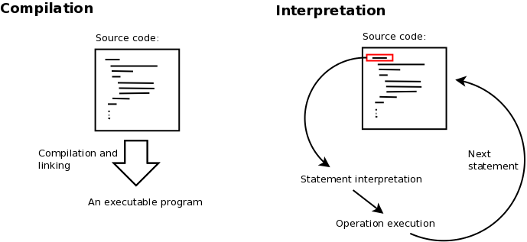
Python is an Interpreter Language
Working | Compiler | Interpreter
Converting code | Convert whole code | Step by step
Translation time | Slow | Fast
Execution time | Fast | Slow
Programming Languages | C, Visual Basic, Java, LabView etc | Python, Matlab, PHP, MS Excel etc

Slide 21
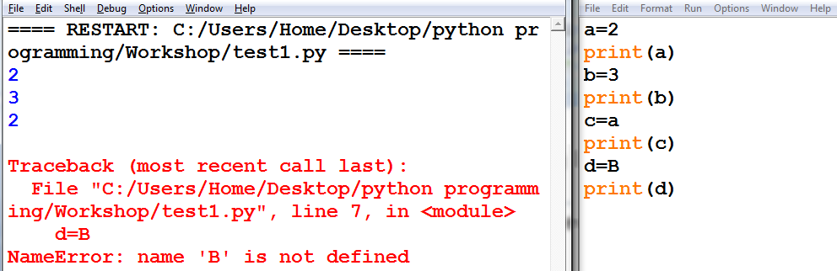
Python Interpreter Example
In Interpreter, if code contains error it may run partially and stop when error occurs. In the following code Error is present in line number 7 that is “d=B” where ‘B’ is not define before, so program runs and execute up to that line.

Slide 22
Comparing Python with C/C++
Programming Parameter | Python Language | C/C++ Language
Programming type | Interpreter | Compiler
Programming Language | High level Language | Middle level Language
Header file | import | #include
Code block | Whitespace Indentation | Code within curly bracket { code}
Single line statement termination | Nothing | Semicolon ;
Control flow (Multi line) statement termination | Colon : | Nothing
Single line comments | # comments | //comments
Multi-line comments | ‘’’ Comments lines ‘’’ | /* Comments lines */
If error code found | Partial run code until find error | Did not run until error is present
Program length | Take fewer lines | Take relatively more lines

Slide 23
THANK YOU

